Slide 1
Harmonic Motion

Slide 2
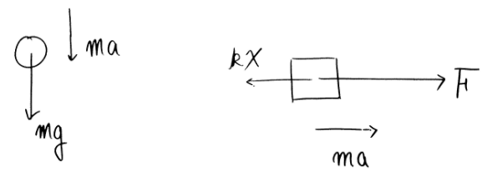
Another Point of View for F=ma

Slide 3
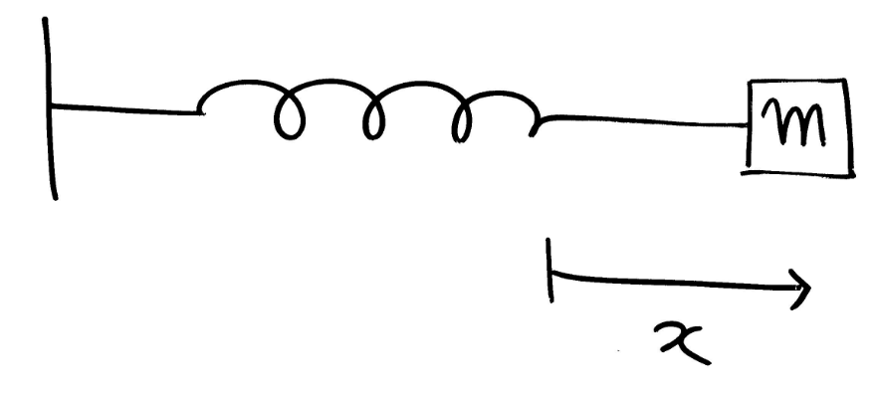


Spring and Mass System

Slide 4
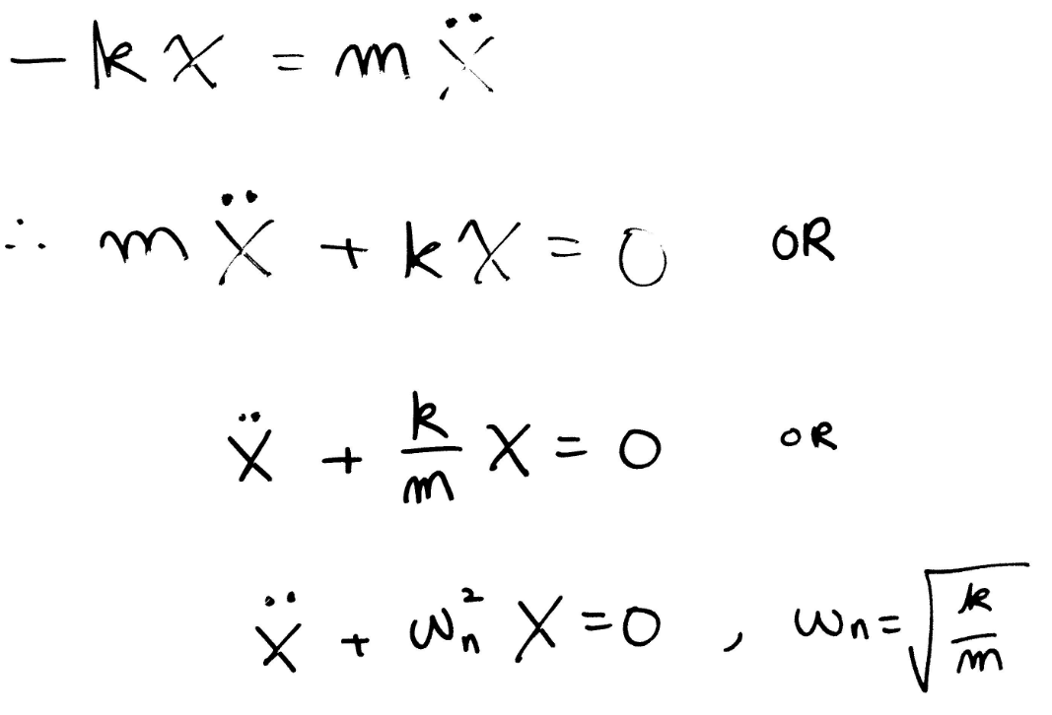

Motion of Equations

Slide 5
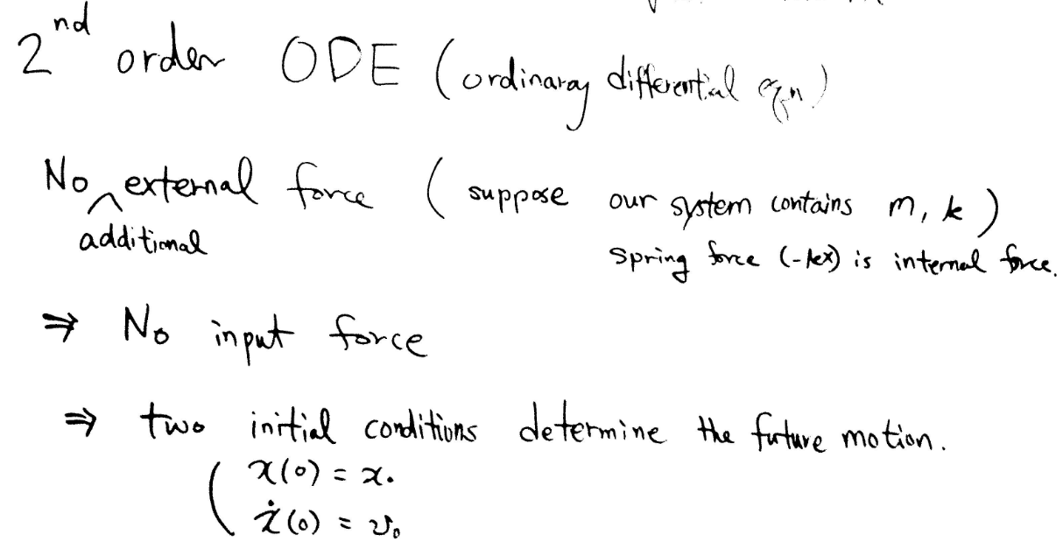
Differential Equation

Slide 6
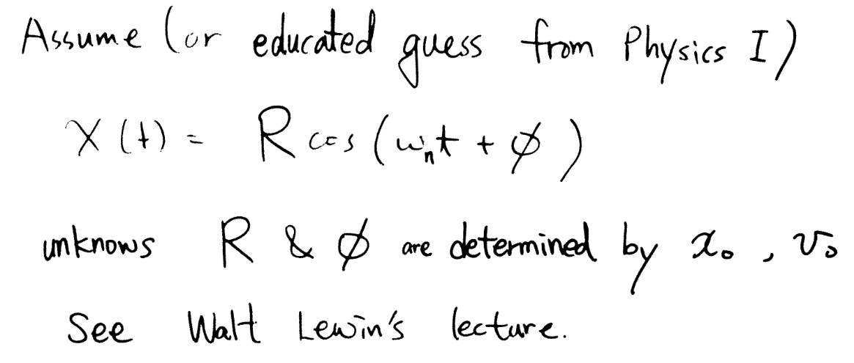
Solutions

Slide 7
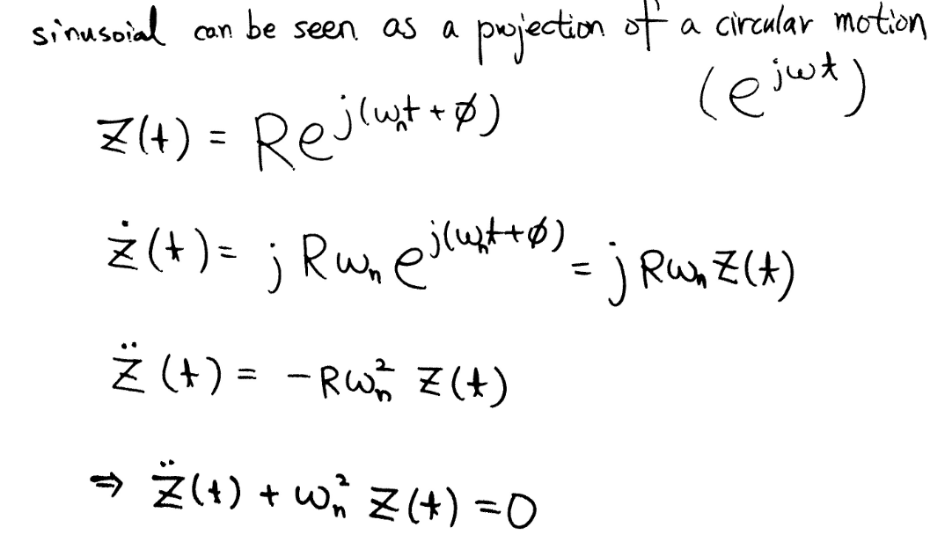
Circular Motion

Slide 8

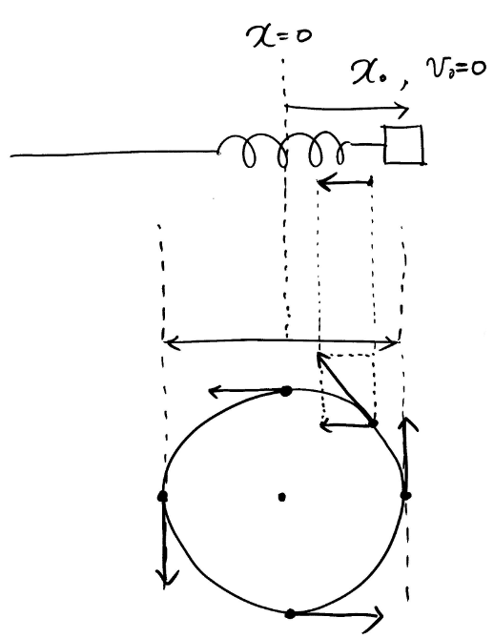
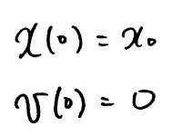

Initial Conditions

Slide 9
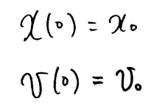
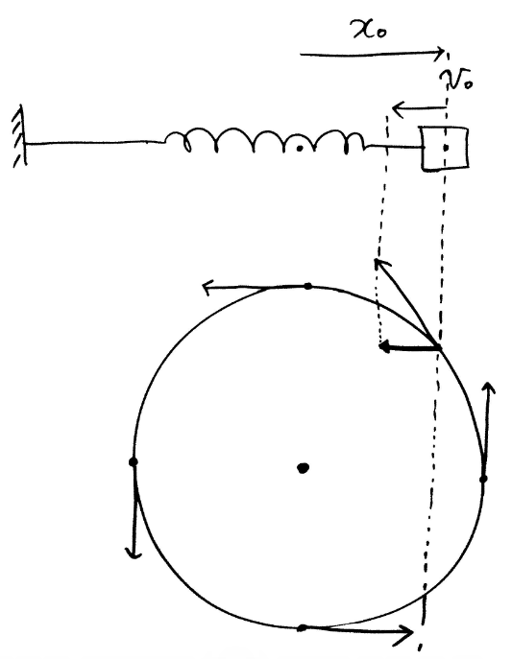
Initial Conditions

Slide 10


Determine Unknown Coefficients

Slide 11
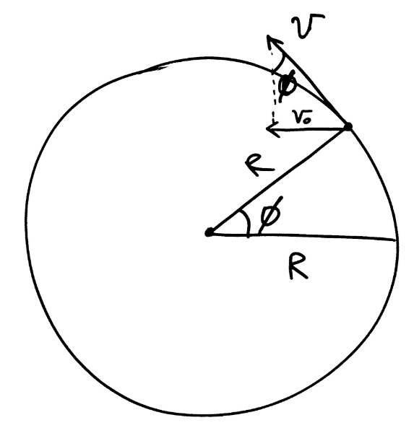
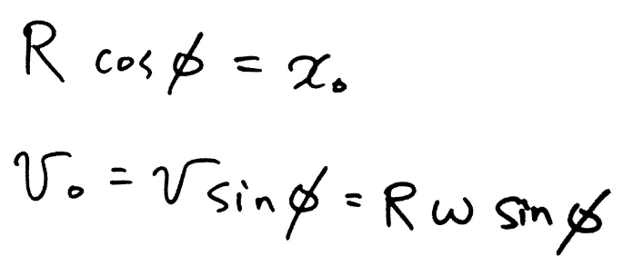
Determine Unknown Coefficients from Circle

Slide 12
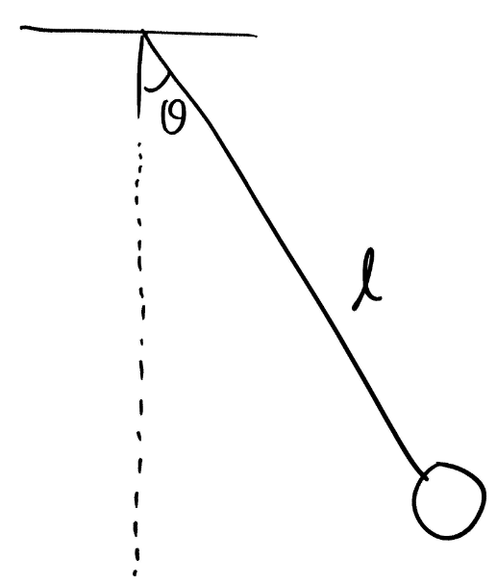
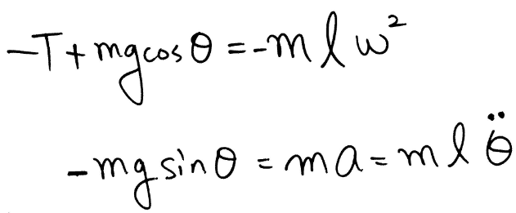
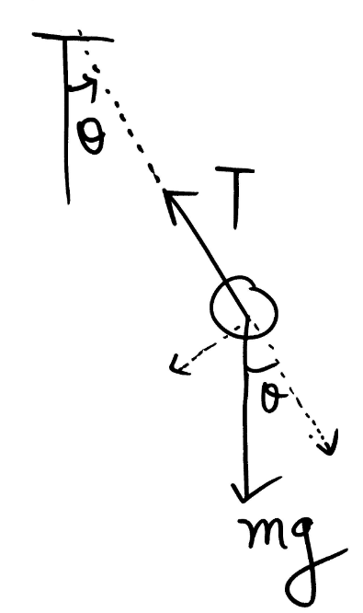
Pendulum

Slide 13
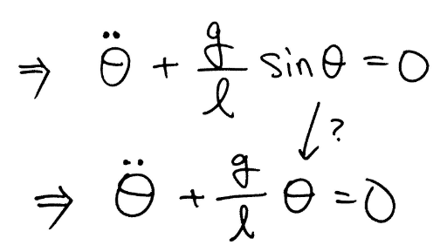
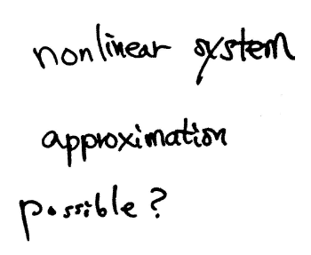
From Nonlinear to Linear

Slide 14




Approximation From Nonlinear to Linear

Slide 15
Note
‘Equation of motion’ means
Apply F=ma to find ordinary differential equations
Its solution will describe how it moves
‘Simple harmonic motion’ means
Equation of motion will satisfy

